Slide 1
DC/DC Converter
건국대 회로 및 보드

Slide 2
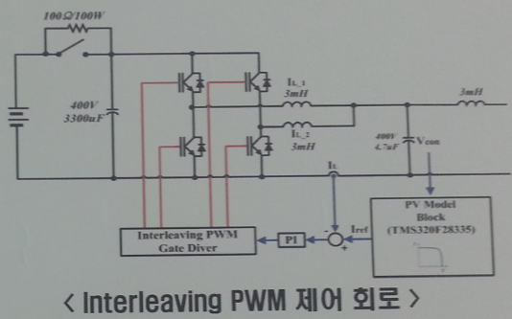
Overall Block
DSP Board
PWM 제어
VDC
(360~400V)
DC/DC Converter
BATT.
(200V)
V+
V+
V-
V-
Buck
Boost

Slide 3
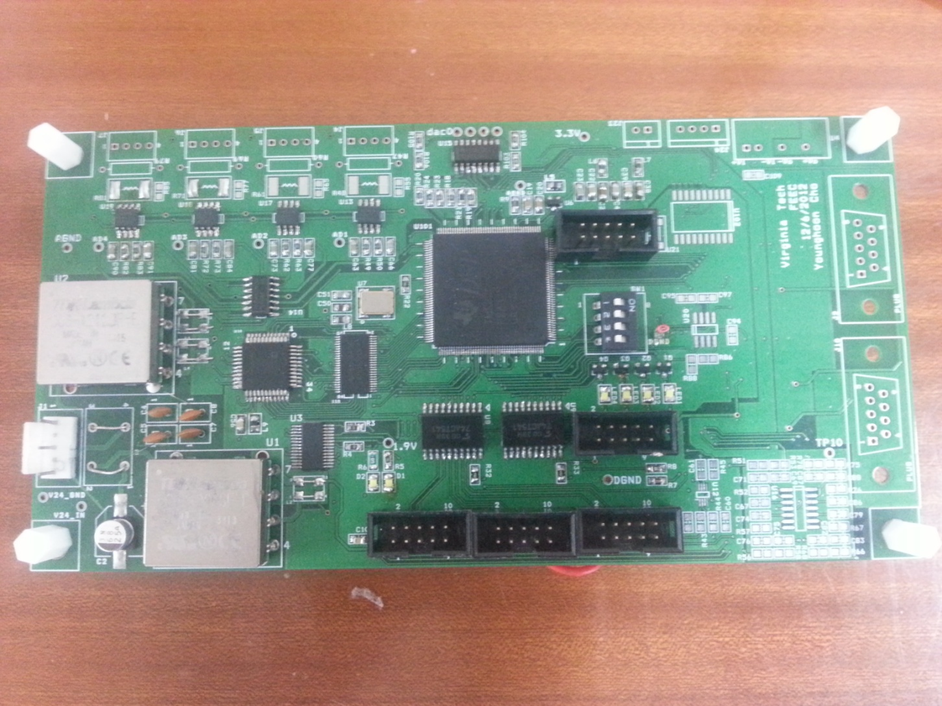
DSP Board
x
ADC
Easy
DSP
PWR
Boot
SW
PWM

Slide 4
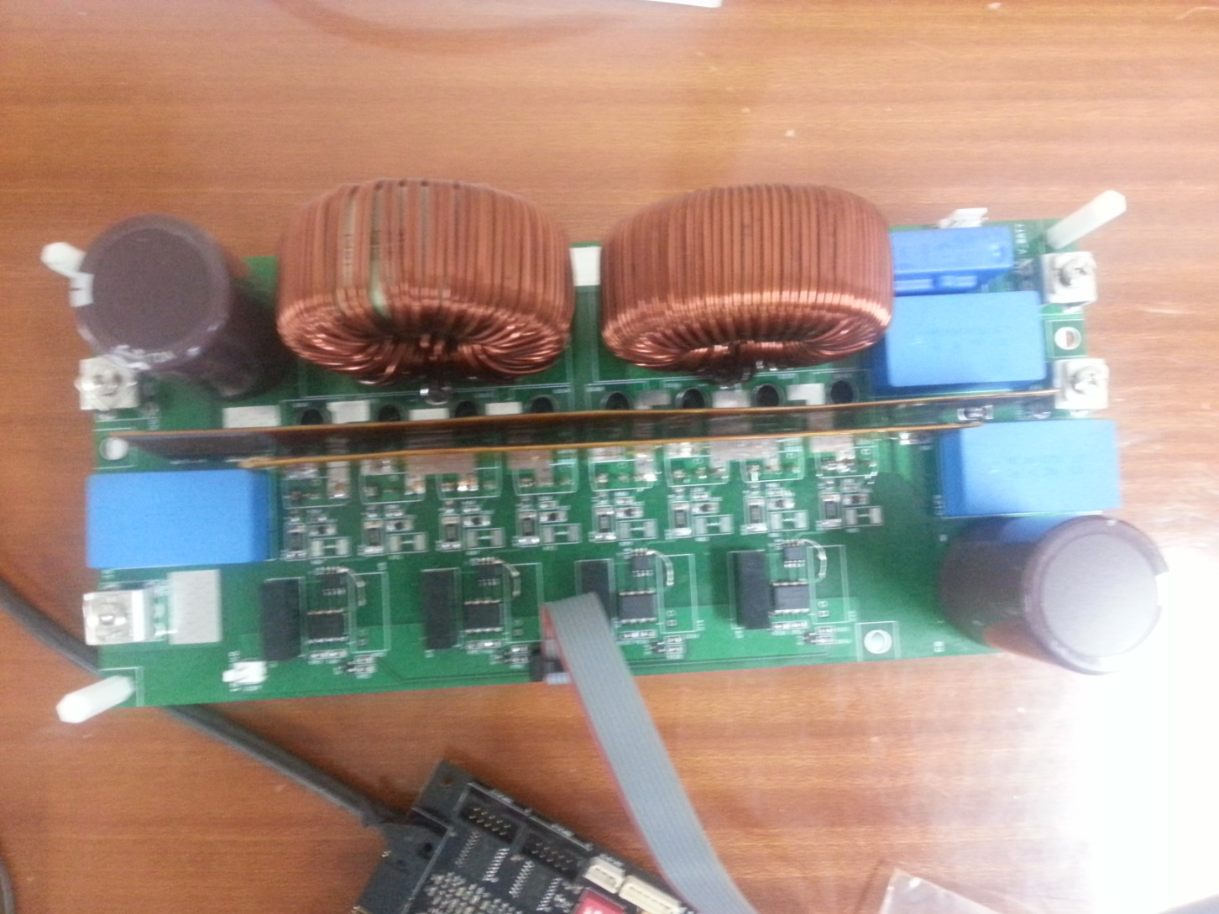
Power Board (DC/DC Converter)
Battery
I/O
200V
VAC
I/O
400V
MOSFET / GATE Driver
PWM
Buck
Boost

